Slide 1



Anna Mitra
Food Redistribution Platform
Team EcoVision | Group 6 | November 2025

Slide 2









Team Details
Product Owner
Solution Architect
DevOps
Kashish Sorathiya 202412035
Anirudh Lohiya 202412074
Mohit Pipaliya 202412072
UI/UX Designers
Business Analyst
Frontend Developers
Rajvi Dhameliya 202412018
Kashish Khubchandani 202412034
Honey Patel 202412067
Kashish Khubchandani 202412034
Bhumi Vyas 202412123
Backend Developers
Scrum Master
Technical Writer
Hardip Muliyashiya 202412021
Mohit Pipaliya 202412072
Rajvi Dhameliya 202412018
Aakash Odedara 202412053
Kashish Sorathiya 202412035

Slide 3
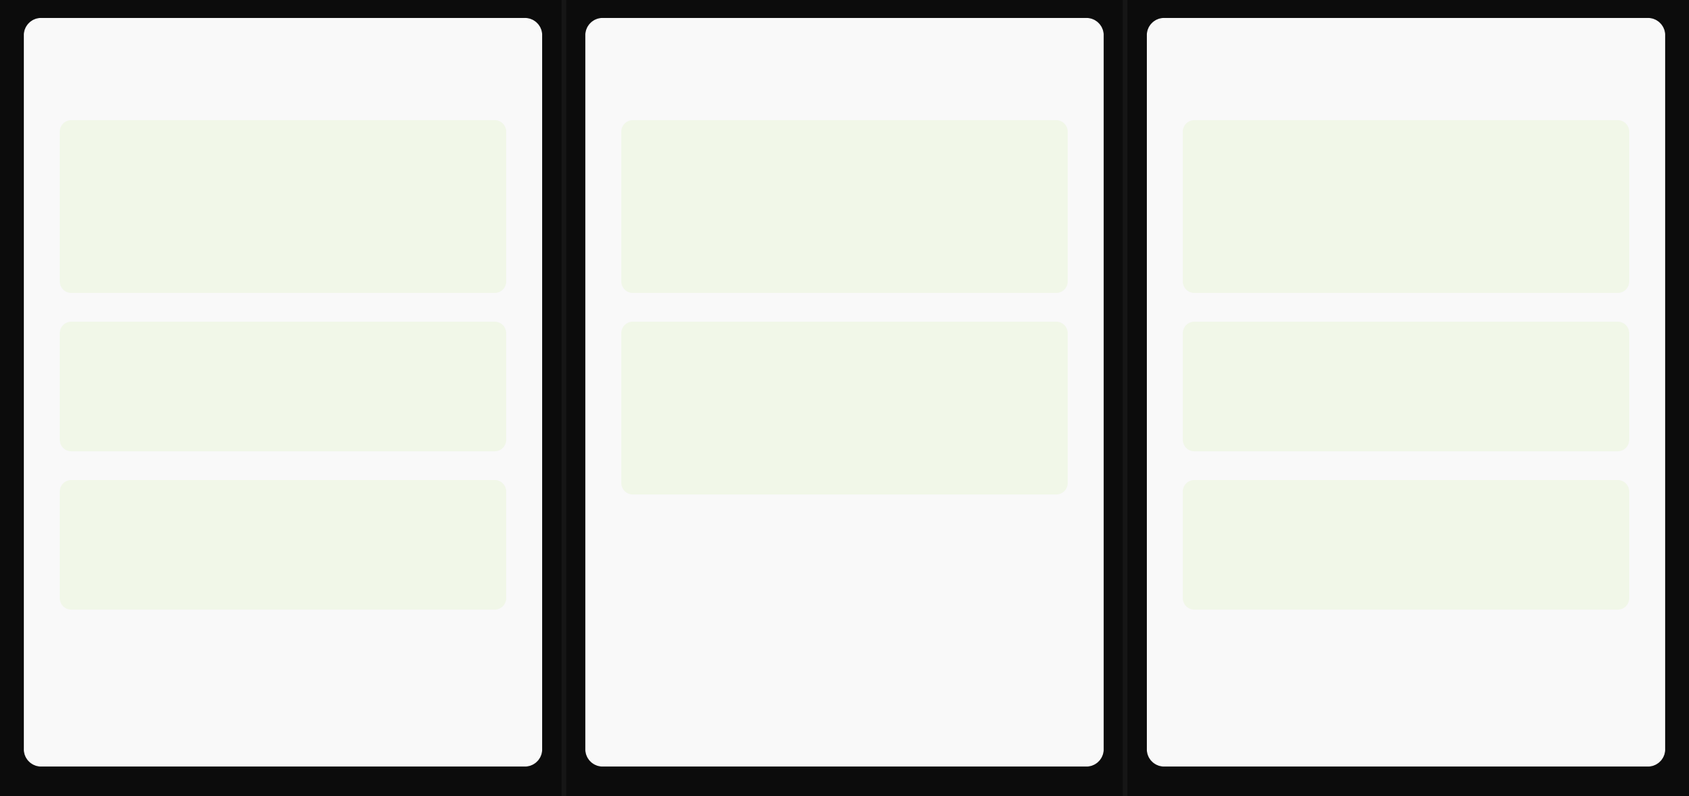





Project Overview
Problem Statement
Motivation
Objectives
Edible food discarded while nearby communities face food insecurity
Create single coordinated system connecting all stakeholders
Fast, reliable matching of surplus food with nearby NGOs/volunteers
No central platform to announce surplus food
Provide end-to-end donation lifecycle management
End-to-end visibility, food safety, trust & accountability
Coordination gaps between donors, NGOs, volunteers
Actionable insights via dashboards and reports

Slide 4







Target Users and System Environment
Target Users
Donor
Individuals or businesses offering surplus food.
NGO
Non-Governmental Organizations facilitating food distribution.
Volunteer
Individuals assisting with pickups and distribution.
Admin
Monitor donations, manage users, moderate content, track metrics
System Environment
Web-based platform supporting multiple devices
Role-specific access with different features per user type
Responsive design for different screen sizes
Real-time notification system

Slide 5


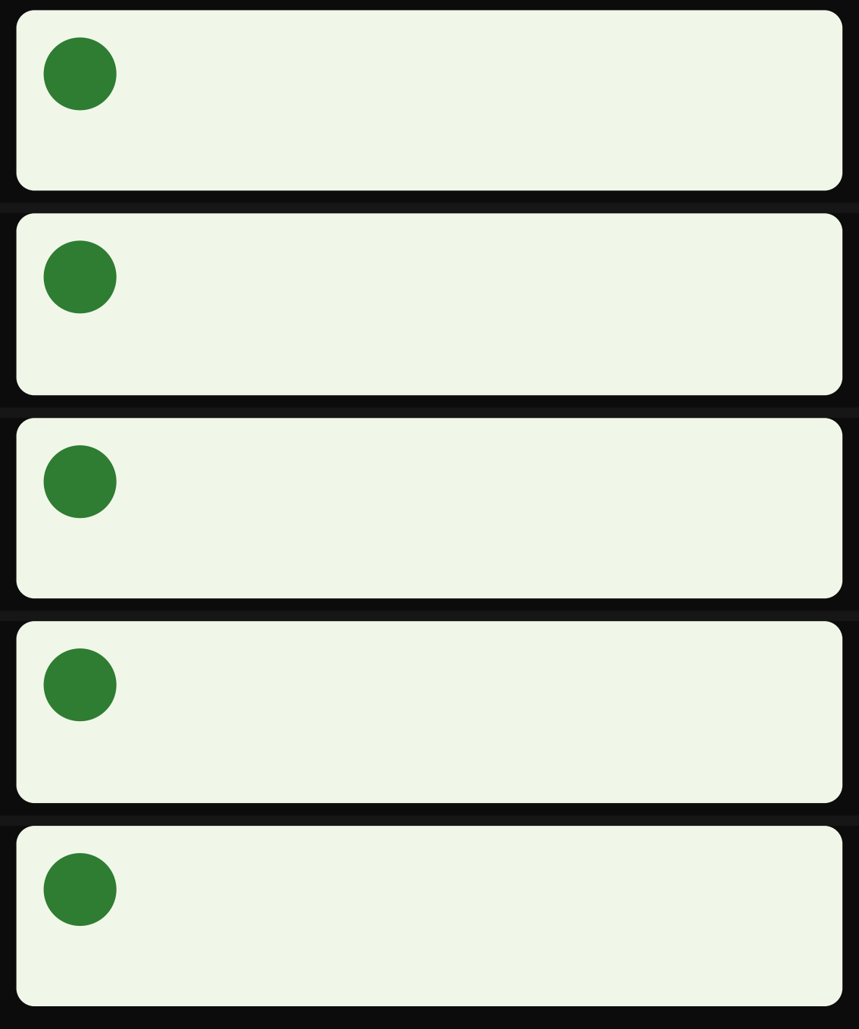
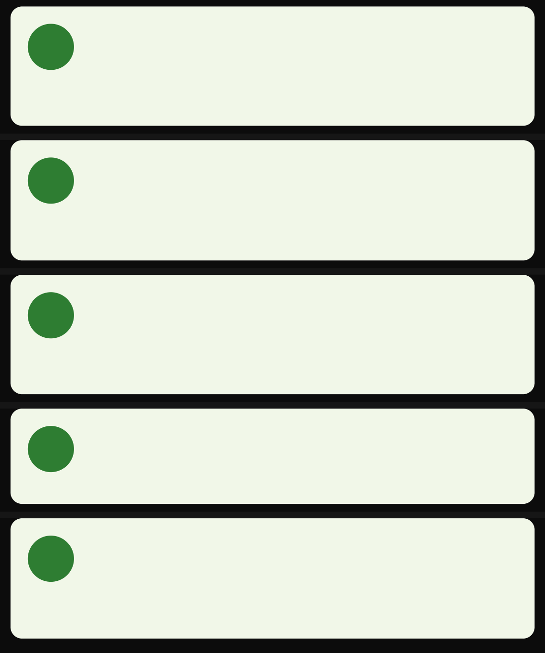










Requirement Specification
Functional Requirements
Non-Functional Requirements
User Registration & Authentication
Email/OTP registration • Role selection • Secure authentication
Donation Management
Create donations • Assign to NGO • Receive notifications • Rate NGOs
NGO Management
View nearby donations • Request/claim • Assign volunteers
Confirm delivery
Volunteer Management
View assigned donations • Complete pickups • Update status • Upload proof
Admin Dashboard
Verify NGOs/users • Monitor donations • Handle disputes • View metrics
Performance
Publish→notify latency < 5s • Support 100+ concurrent users
Security & Privacy
Passport authentication • Password hashing • Encrypted data
Usability & Accessibility
Simple UI • Large buttons • Readable contrast • Mobile- friendly layout
Localization
Support for English, Hindi, Gujarati
Scalability & Maintainability
Modular backend architecture • Separate frontend/backend repositories

Slide 6




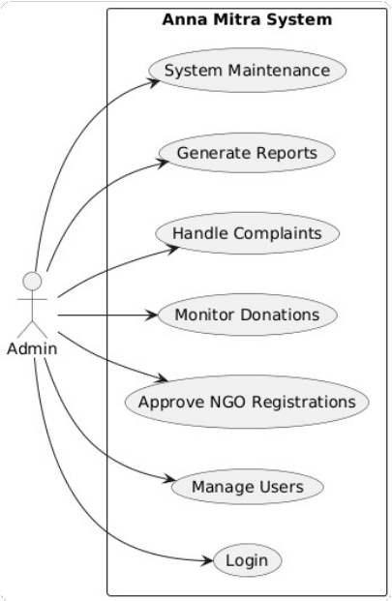
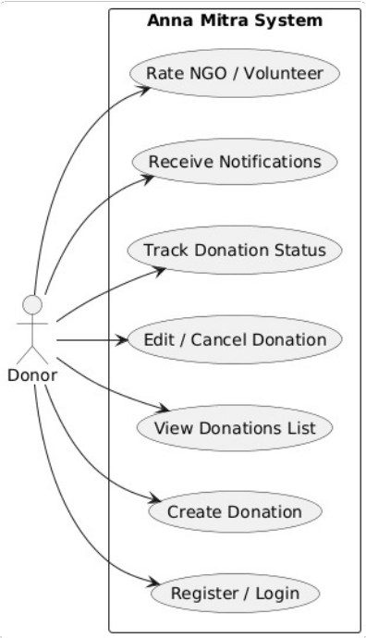
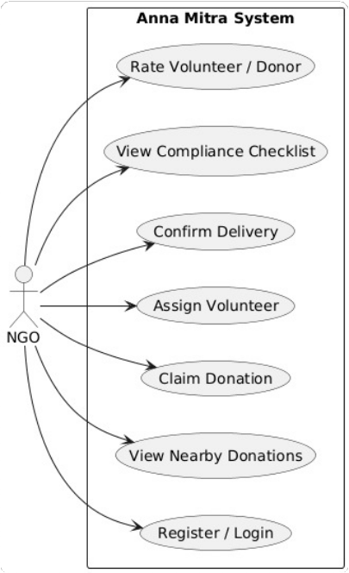
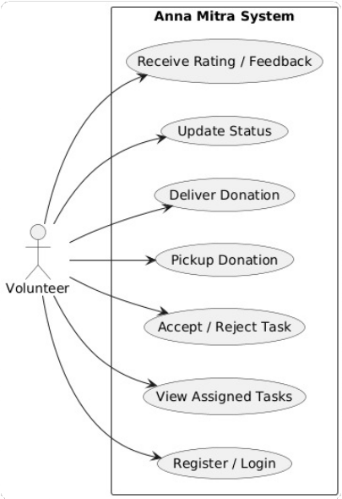
Use Case Diagrams
Admin Use Case
Donor Use Case
NGO Use Case
Volunteer Use Case

Slide 7





User Stories
User Stories
Donor
As a Donor, I want to create a donation post so that nearby NGOs can request it
NGO
As an NGO, I want to view nearby open donations so that I can claim them
Volunteer
As a Volunteer, I want to see my assigned pickup points on a map so I can plan efficient routes
Admin
As an Admin, I want to verify NGOs and manage users to ensure platform security and reliability

Slide 8








Technology Stack
Technology Choices
Frontend: React
Component-based
Backend: Node.js + Express
JavaScript full-stack High-performance
Efficient rendering
Rich ecosystem
Lightweight
Database: MongoDB
Flexible document model
Authentication: Passport.js
Modular auth middleware Multiple strategies
Easy scaling
Node.js integration
Easy integration
System Architecture Benefits
Responsive design Modular architecture
Full-stack JavaScript
RESTful API
Cloud deployment

Slide 9


Conclusion
Project Strengths & Challenges
Strengths
Potential Challenges
End-to-end solution - Complete donation lifecycle
Volunteer shortage - May affect pickup efficiency
Multi-role coordination - Connects all stakeholders
Food safety risks - Requires strict monitoring
Transparency & accountability - Ratings & delivery proof
Scalability issues - Challenges with user growth
Food safety - Time windows & safety checklists

Slide 10




"
When we give cheerfully and accept gratefully, everyone is blessed.
Thank You
Maya Angelou
Thank You

Slide 11
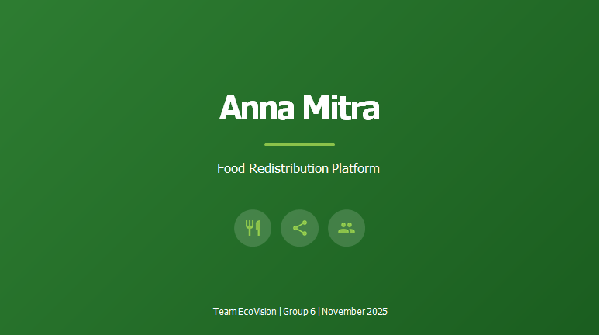










Annamitra
Anna Mitra
Team Details
UI/UX Designers
Business Analyst
Team Leader & Scrum Master
Rajvi Dhameliya (202412018)
Kashish Khubchandani (202412034)
Mohit Pipaliya (202412072)
Product Owner
Kashish Khubchandani (202412034)
Kashish Sorathiya (202412035)
Solution Architect
Anirudh Lohiya (202412074)
DevOps Engineer
Mohit Pipaliya (202412072)
Frontend Developers
Backend Developers
Technical Writer
Honey Patel (202412067)
Hardip Muliyashiya (202412021)
Rajvi Dhameliya (202412018)
Bhumi Vyas (202412123)
Aakash Odedara (202412053)
Kashish Sorathiya (202412035)
Group 6

Slide 12
Introduction
A digital platform connecting donors, NGOs, and administrators to streamline food donation.
Ensures efficient food distribution by reducing wastage and feeding those in need.
Provides real-time donation tracking and status updates to all users.
Supports role-based access for donors, NGOs, and admins with secure authentication.
Automates notifications for donation status, approvals, and feedback.
Includes feedback and inquiry modules to improve transparency and engagement.
Built with a focus on scalability, usability, and social impact.

Slide 13
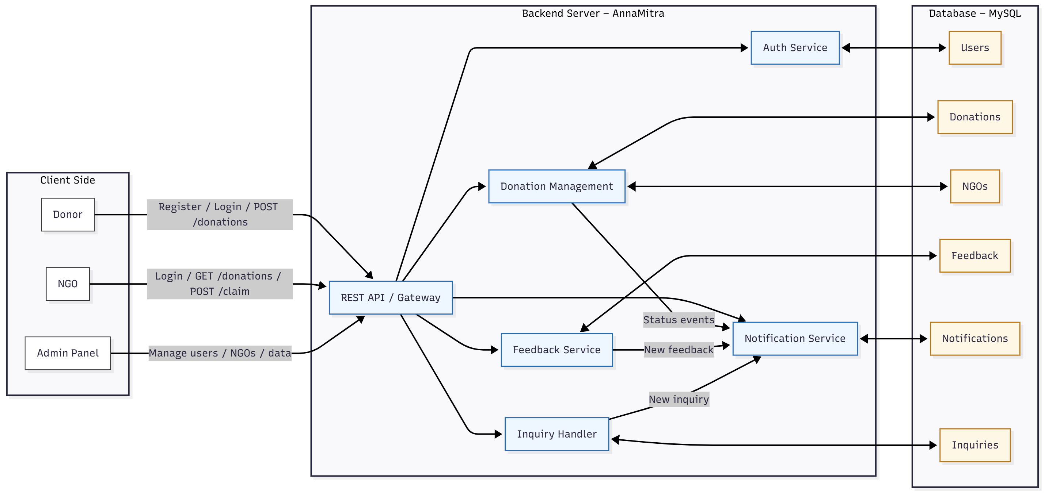
System Design

Slide 14
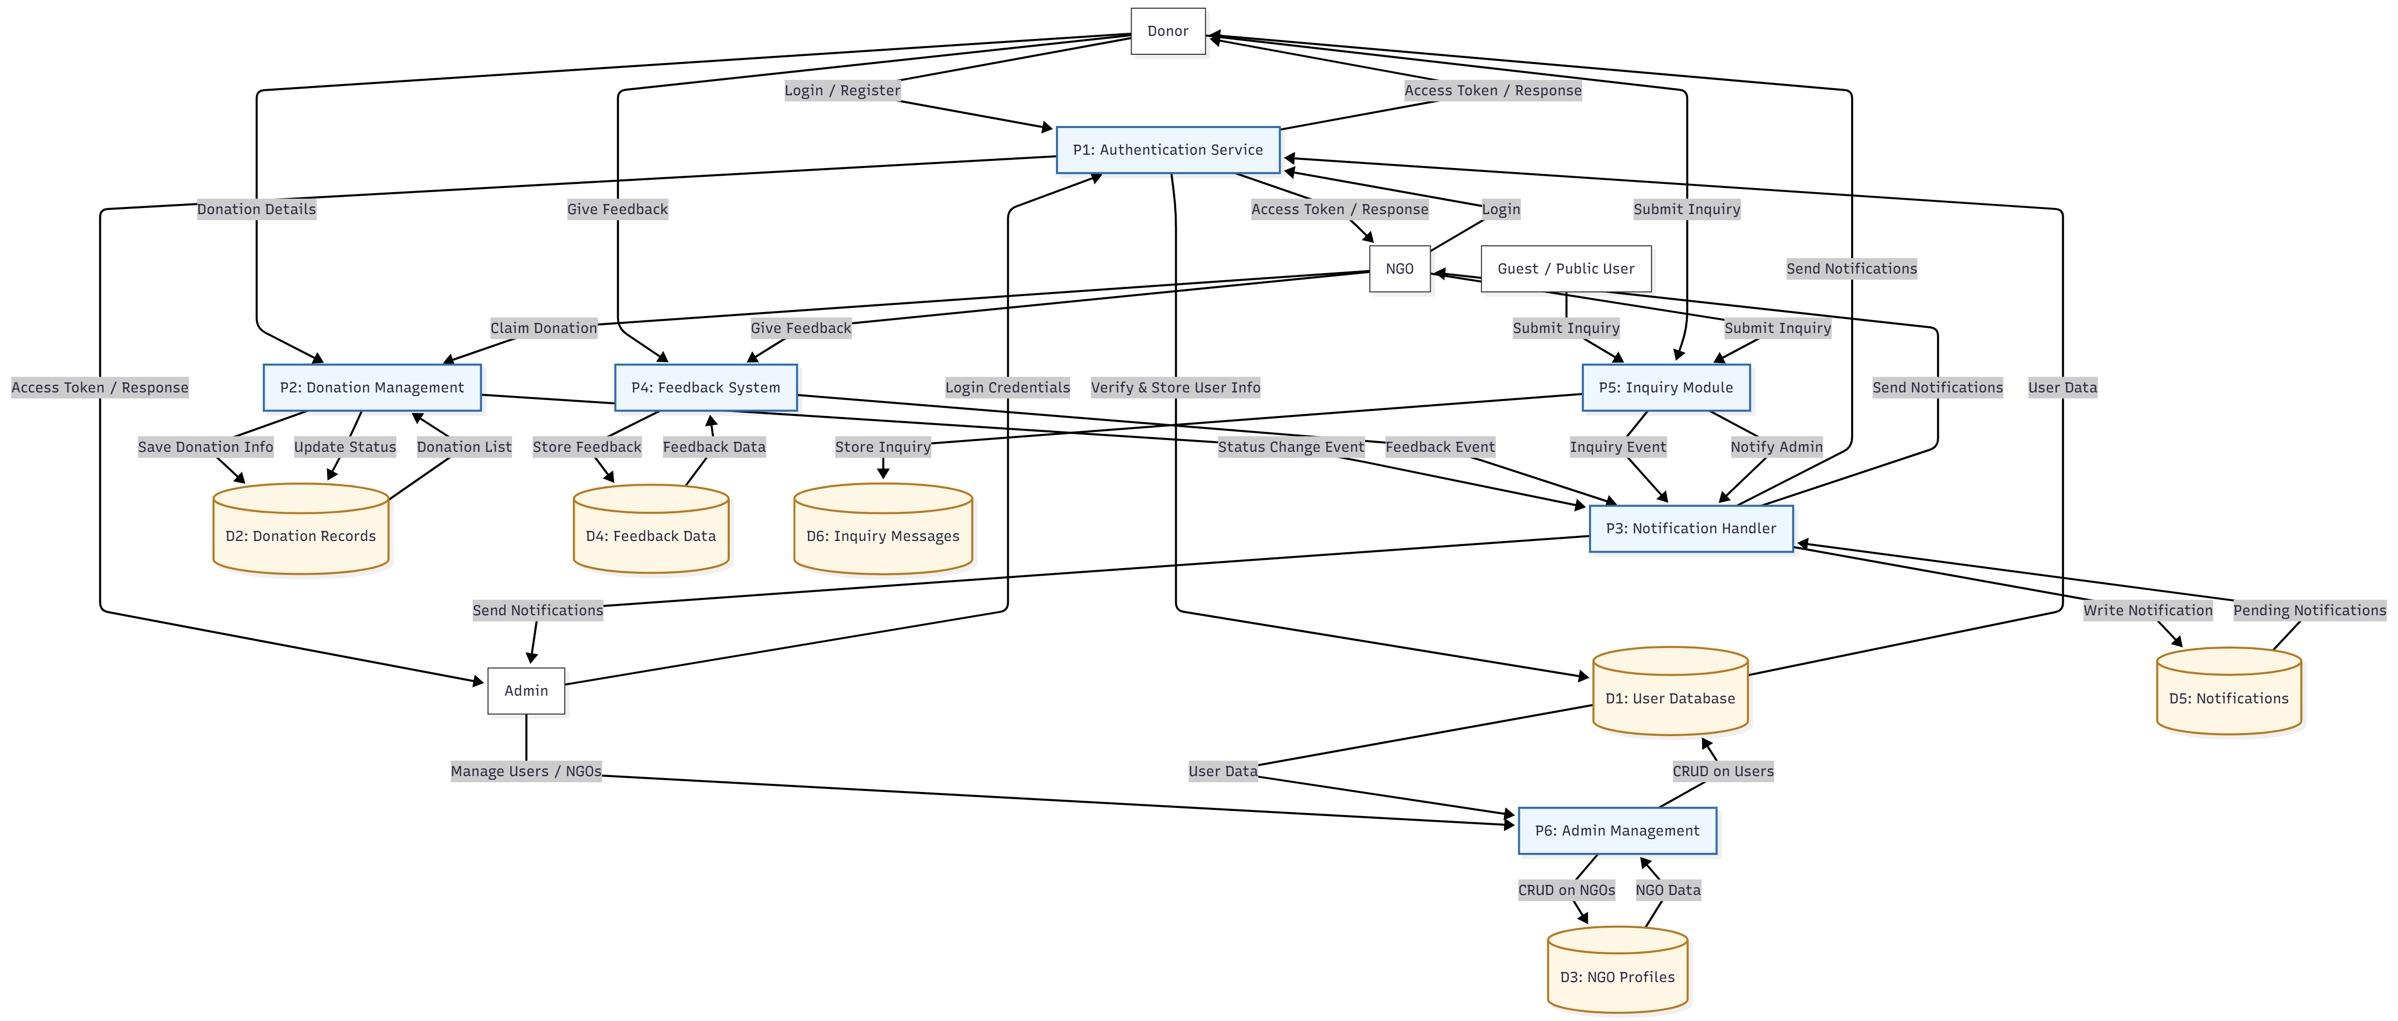
Data Flow Diagram

Slide 15
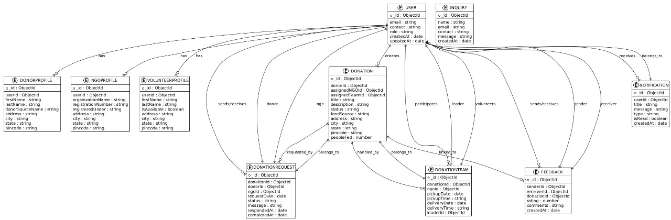
ER Diagram

Slide 16
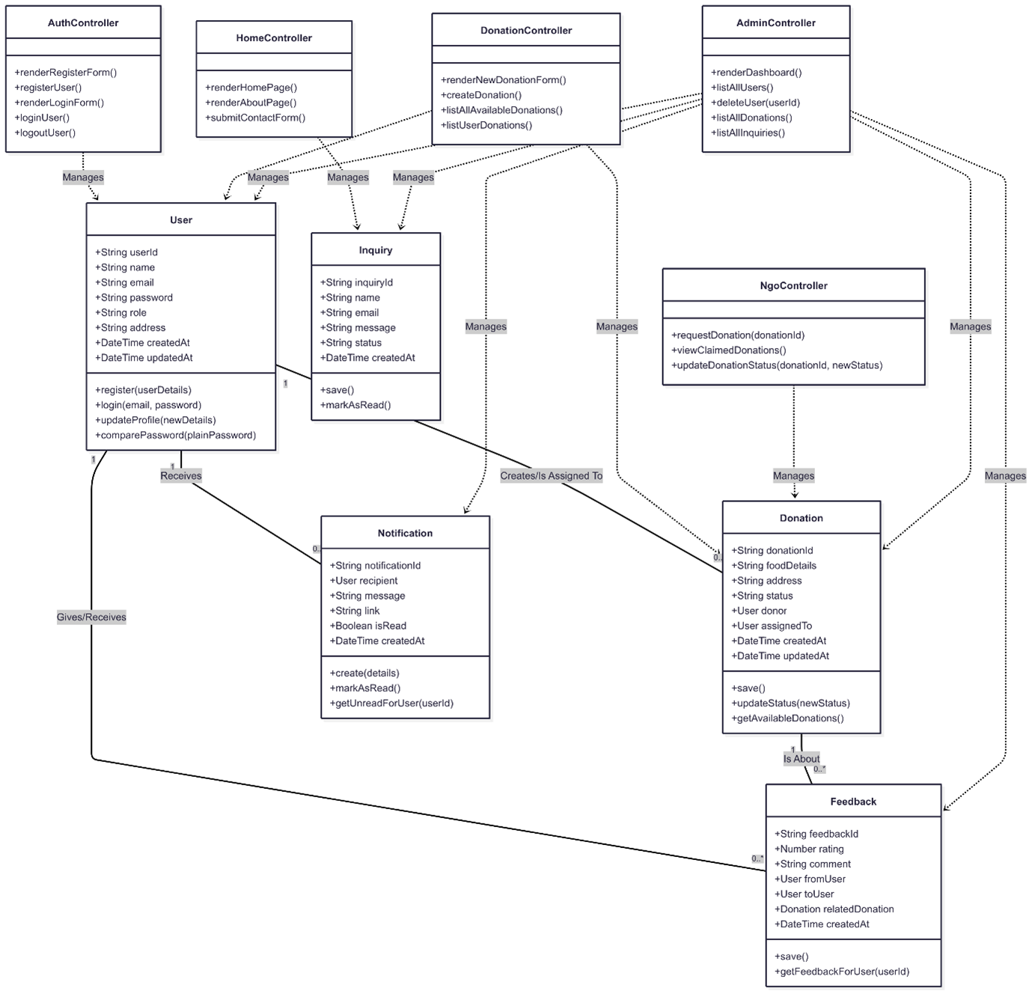
Class Diagram

Slide 17



Schema Design
Key Entities
Core Relationships
Design Principles
User: donors, NGOs, admins (role-based)
User creates Donation (1:N)
3NF: attributes depend on the key, the whole key, and nothing but the key
NGO: organizational profile (optionally mapped to a User)
NGO assigned to Donation (1:N; nullable until claimed)
Status enums: Donation(AVAILABLE,REQUESTED,PICKED_UP,COMPLETED,CANCELLED)
Donation: food listing + lifecycle status
Status enums: Inquiry(OPEN,RESOLVED,CLOSED)
User writes Feedback for Donation to another User
Timestamps: created_at, updated_at; server-generated
Feedback: rating/comment from one user to another for a donation
FK rules: ON UPDATE CASCADE; deletes restricted if historical data exists
Indexes: users.email (unique), donations.status, donations.created_at, notifications.user_id,is_read, feedback.donation_id, ngo.name
User receives Notifications (1:N)
Notification: system messages to users
User submits Inquiry (1:N; allow guest rows if needed)
Inquiry: contact/support requests

Slide 18
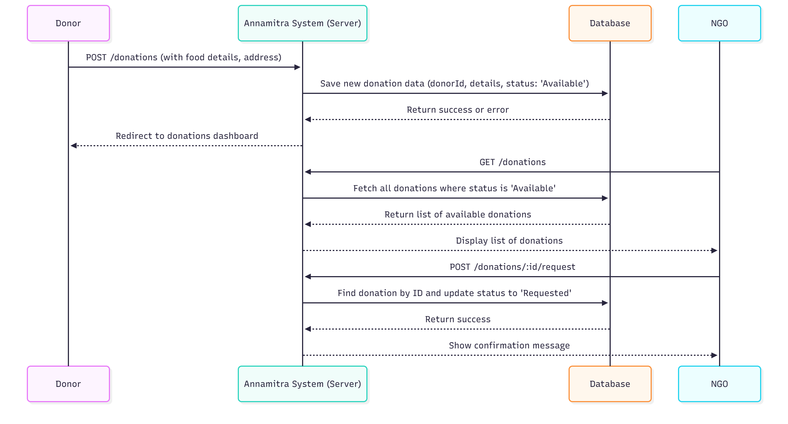
Sequence Diagram

Slide 19


Design Patterns
Builder Pattern
Prototype Pattern
Creates complex objects step by step, allowing flexibility in construction
Creates new objects by copying existing ones instead of creating from scratch
Usage in AnnaMitra:
Usage in AnnaMitra:
Building donation forms with multiple optional fields (food type, quantity, expiry time, pickup address) before creating the final donation object
When a donor wants to "repeat" or "clone" a previous donation entry — system duplicates old donation data and allows modification of small details (like pickup time)

Slide 20


Design Patterns
Facade Pattern
Observer Pattern
Provides a simplified interface to complex subsystems
Defines one-to-many relationship for automatic notifications when state changes
Usage in AnnaMitra:
Usage in AnnaMitra:
Backend services like NotificationService that hide complexity of sending emails, in-app alerts, and database updates through a single unified interface
When a donor updates donation status or NGO accepts a request, all related users (volunteers, NGOs, donors) receive real-time updates automatically

Slide 21



Thank You
"
Alone we can do so little; together we can do so much.
Helen Keller
Thank You

Slide 22

AnnaMitra
Food Distribution Platform
Team Ecovision | Group 6 | November 2025

Slide 23
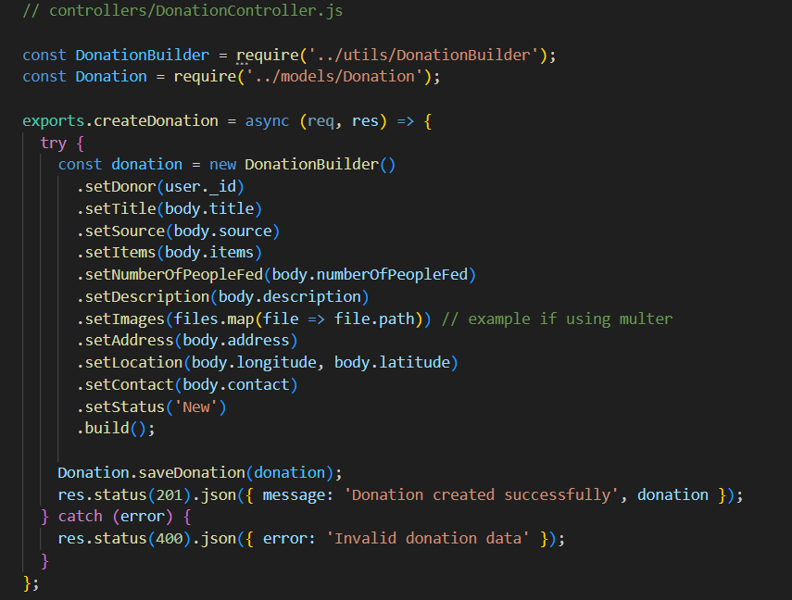
Code walkthrough
Builder Pattern
// controllers/DonationController.jsconst DonationBuilder = require('../utils/DonationBuilder');const donation = new DonationBuilder() .setDonor(req.user._id) .setItems(req.body.items) .setPickupTime(req.body.pickupTime) .setLocation(req.body.location) .setExpiryDate(req.body.expiry) .build();
The Builder Pattern constructs complex objects step by step, making code cleaner and more maintainable. In AnnaMitra, it creates donation objects with optional properties like donor details, items, pickup time, location, and expiry date.
Key Benefits
Flexible object construction
Readable controller code
Easy property management

Slide 24

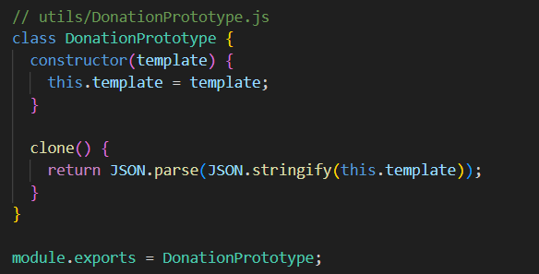
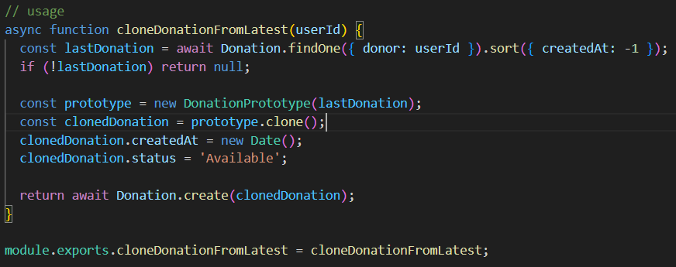
Prototype Pattern
The Prototype Pattern clones existing objects instead of creating them from scratch. In AnnaMitra, frequent donors can quickly duplicate their last donation, streamlining repeat contributions with identical item types.

Slide 25
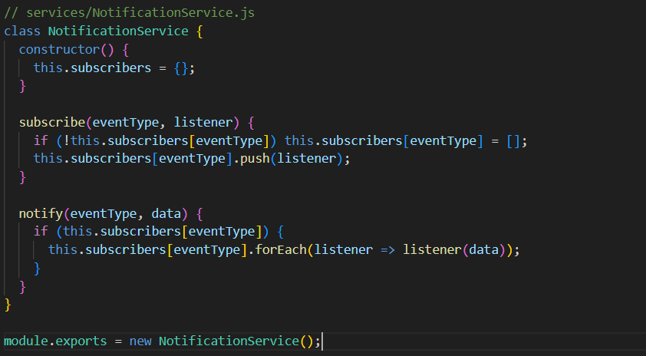

Code walkthrough
Observer Pattern
The Observer Pattern enables automatic notifications when donation events occur. Multiple stakeholders — NGOs, donors, and volunteers — are instantly updated through a centralized notification service.

Slide 26
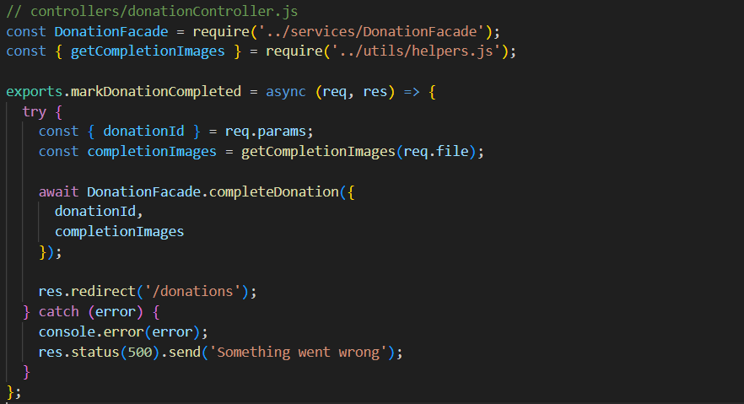
Code Walkthrough
Facade Pattern
The Facade Pattern simplifies complex workflows behind a single, clean interface. When marking a donation as completed in AnnaMitra, multiple operations occur seamlessly: status updates, image uploads, notifications, and feedback generation.

Slide 27
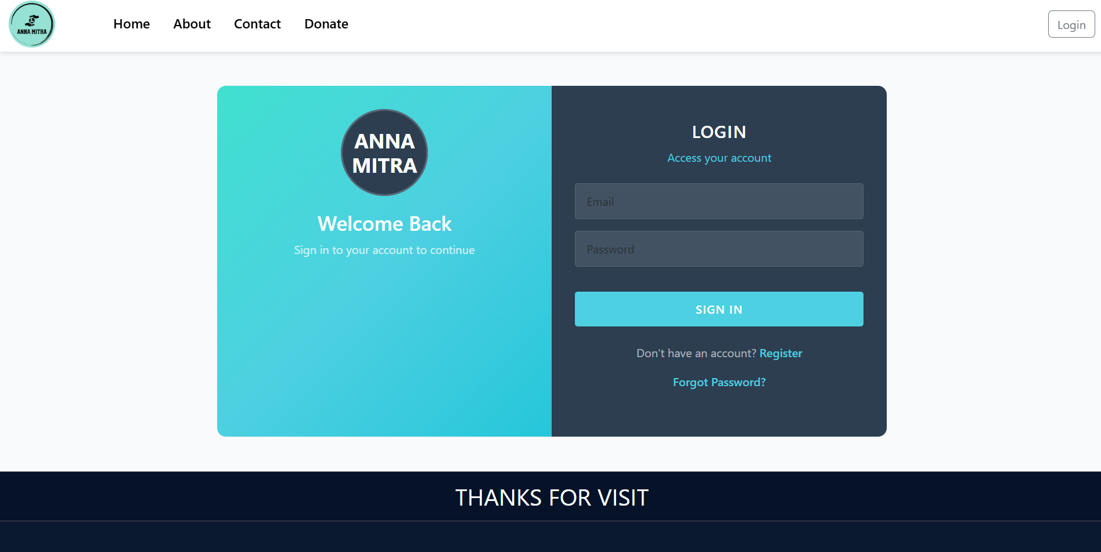
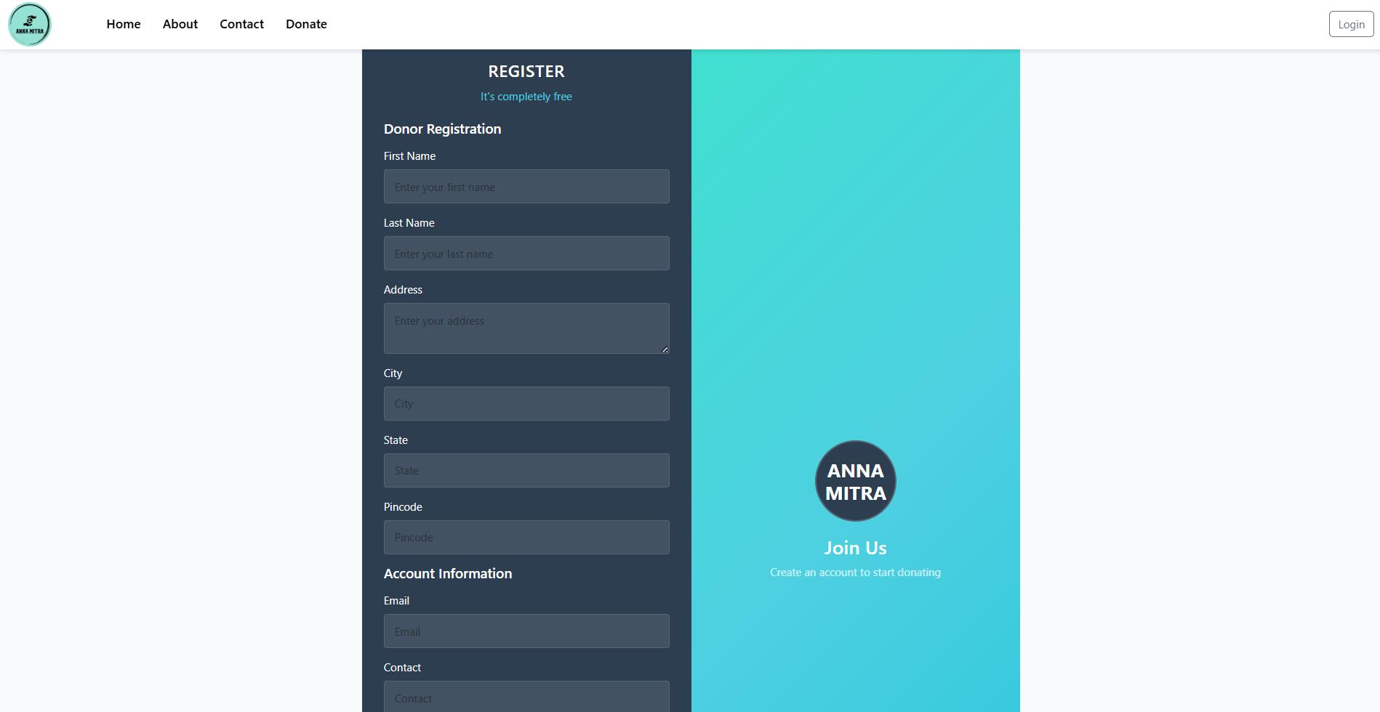
Functional Prototype
Login
Registration
New users create accounts with role selection (Donor, NGO, Volunteer, or Admin) and secure credential storage.
Authenticated access with session management ensures secure platform entry for all user types.

Slide 28
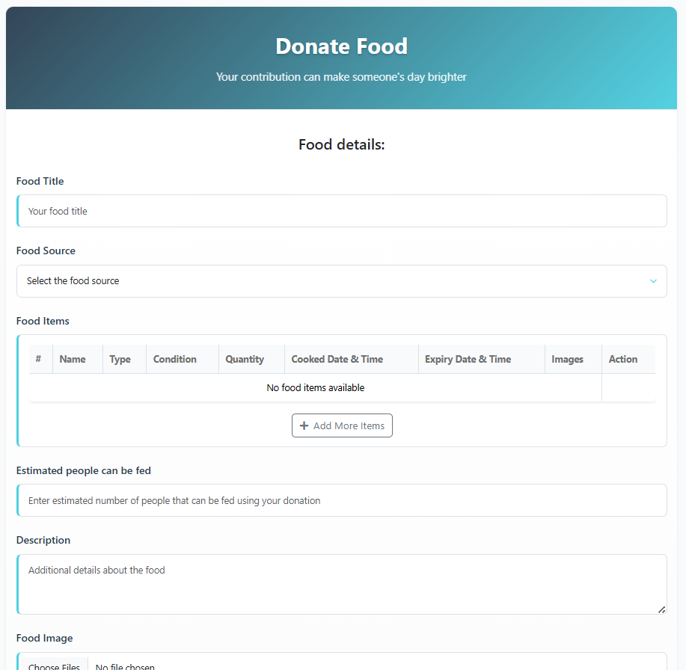
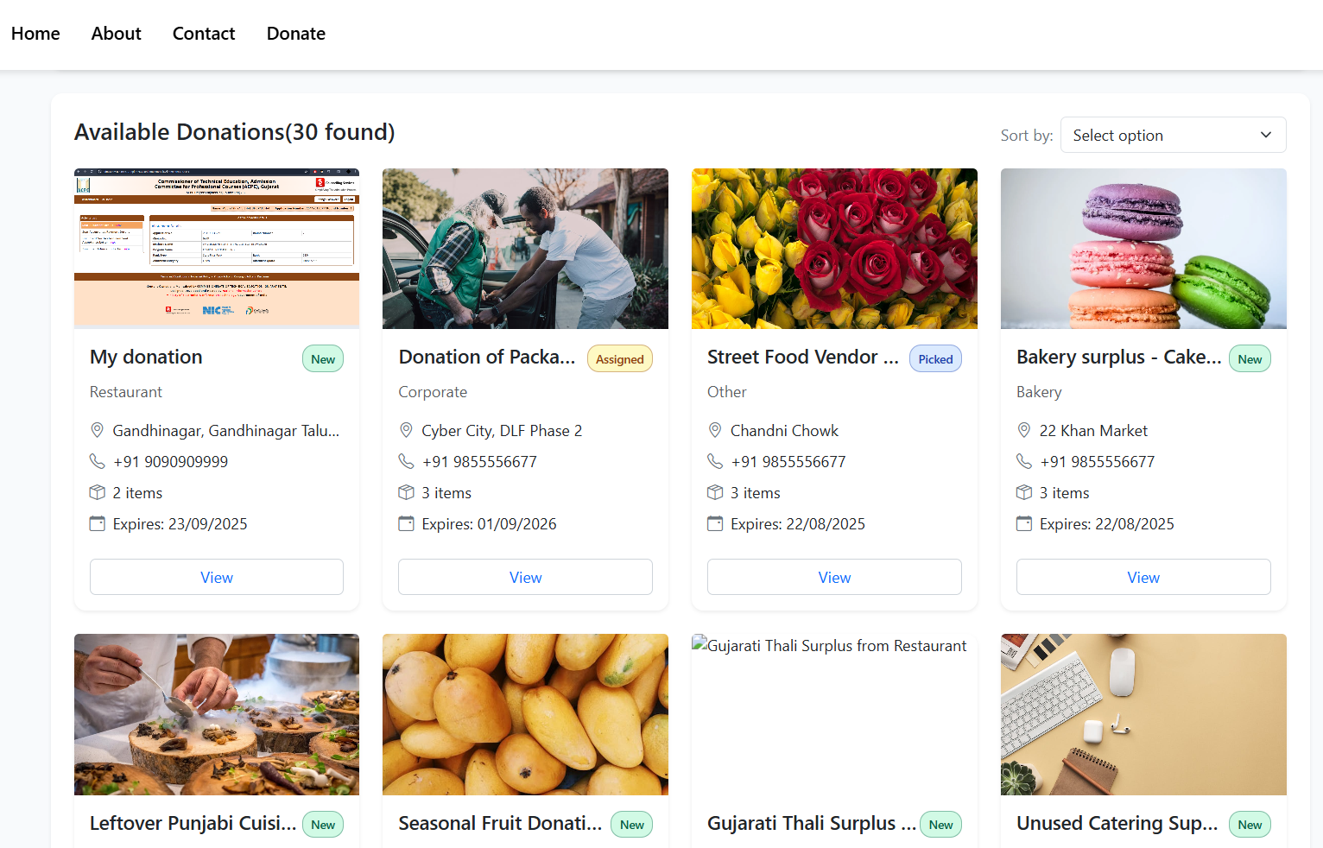
Functional Prototype - Core Donation Features
Donation Form
Donations List
Donors submit detailed information including food items, quantities, pickup location, expiry dates, and availability windows.
A comprehensive view displays all donations with filtering options by status, location, and urgency for efficient matching.

Slide 29

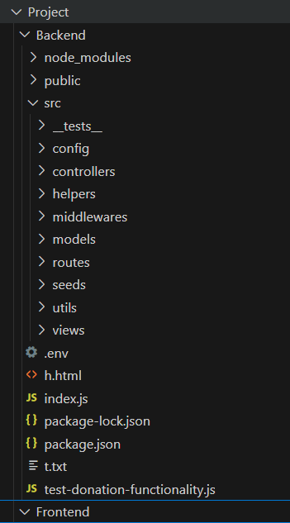
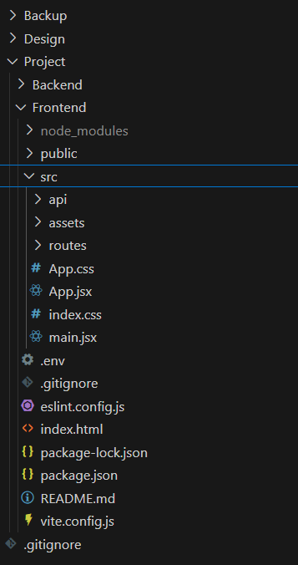
Repository Structure
The AnnaMitra codebase follows a modular MVC architecture with clear separation of concerns. Controllers handle routing logic, models define data schemas, services implement business logic, and utilities provide reusable helper functions.

Slide 30

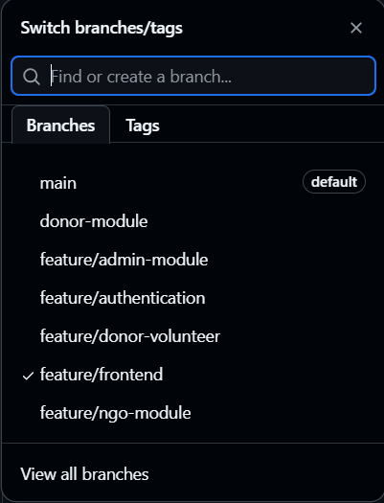
Version Control & Collaboration
Our team implemented a structured Git workflow using GitHub for version control, enabling parallel feature development and seamless integration. This approach minimized conflicts and maintained code quality throughout the project lifecycle.
1
Main Branch
Stable production-ready code for deployment and final testing
2
Feature Branches
feature/frontend — UI components and styling. feature/ngo-module — NGO dashboard functionality. feature/donor-volunteer — Donor and volunteer workflows
3
Core Modules
feature/admin-module — Admin controls and verification. feature/authentication — Login and security. donor-module — Donor-specific operations

Slide 31

Thank You
We appreciate your time and attention in reviewing the AnnaMitra platform. This project demonstrates our commitment to leveraging design patterns and modern development practices to create meaningful solutions that connect food donors with those in need.
Team Ecovision looks forward to your feedback and questions.

